Slide 1
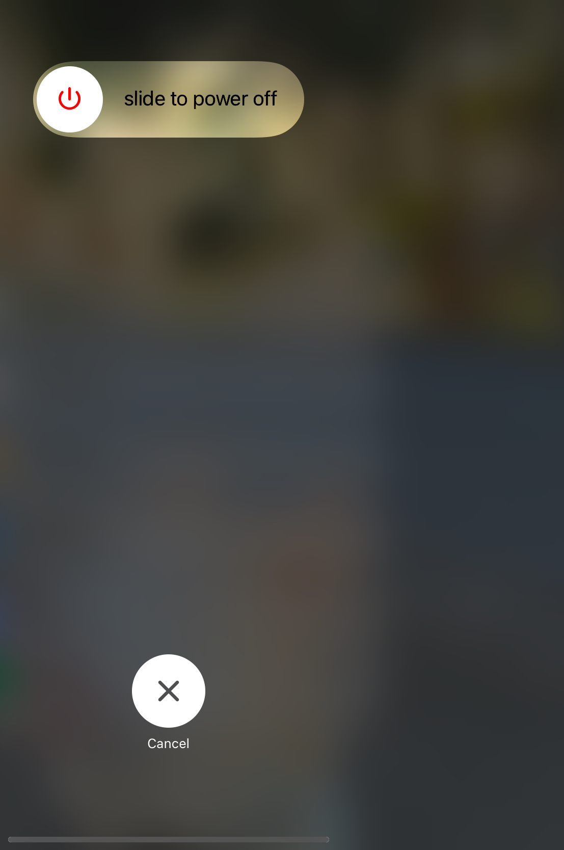
Goodbye
A Samuel Pottinger
Stat 198: IDSV
April 23, 2025

Slide 2
Today
> What’s next?
Inquiry Based Design
Final Projects
Goodbye

Slide 3
Today
What’s next?
> Inquiry Based Design
Final Projects
Goodbye

Slide 4
Inquiry-based design
Why do some visualization artists talk about questions?
Notes:
https://stamen.com/data-visualization-for-education-when-asking-questions-is-the-answer/

Slide 5
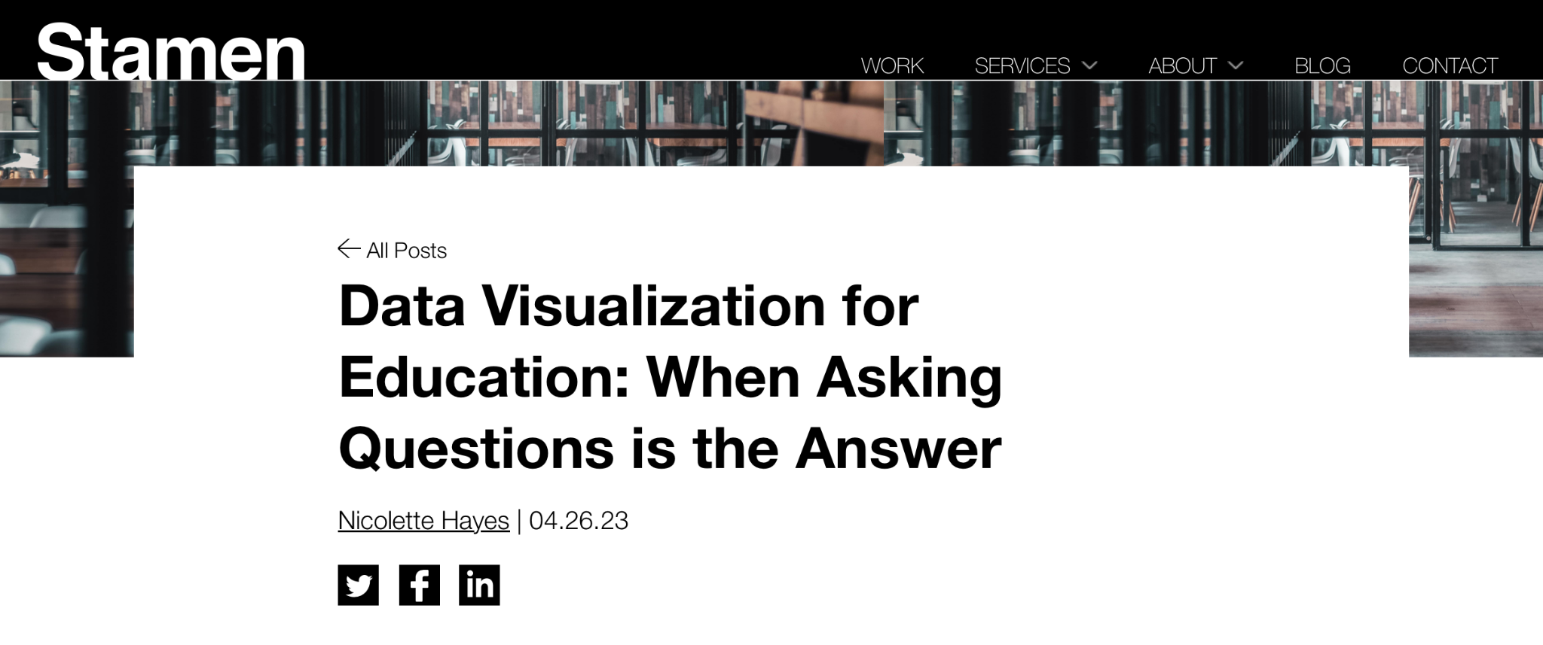
Inquiry-based design
Notes:
https://stamen.com/data-visualization-for-education-when-asking-questions-is-the-answer/

Slide 6
Inquiry-based design
Zoom in, zoom out, zoom part way in.
All roads lead to Rome.
Layer into complexity, trust your users.

Slide 7
Today
What’s next?
Inquiry Based Design
> Final Projects
Goodbye

Slide 8
Explore for a moment on your own
Look at the available datasets.
Continue forward for a moment with your chosen dataset.
What are the central questions that would be interesting to explore within this dataset?

Slide 9
Talk about your answers with a partner
Look at the available datasets.
Continue forward for a moment with your chosen dataset.
What are the central questions that would be interesting to explore within this dataset?
Discuss with a partner and then send your response.
If you do not want to be part of the friends and family allowed section, please send me a direct message.

Slide 10
Today
What’s next?
Inquiry Based Design
Final Projects
> Goodbye

Slide 11







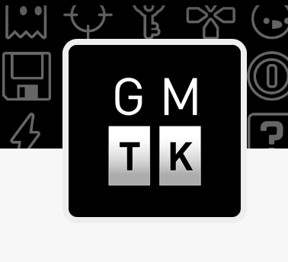

Other places to go next

Slide 12
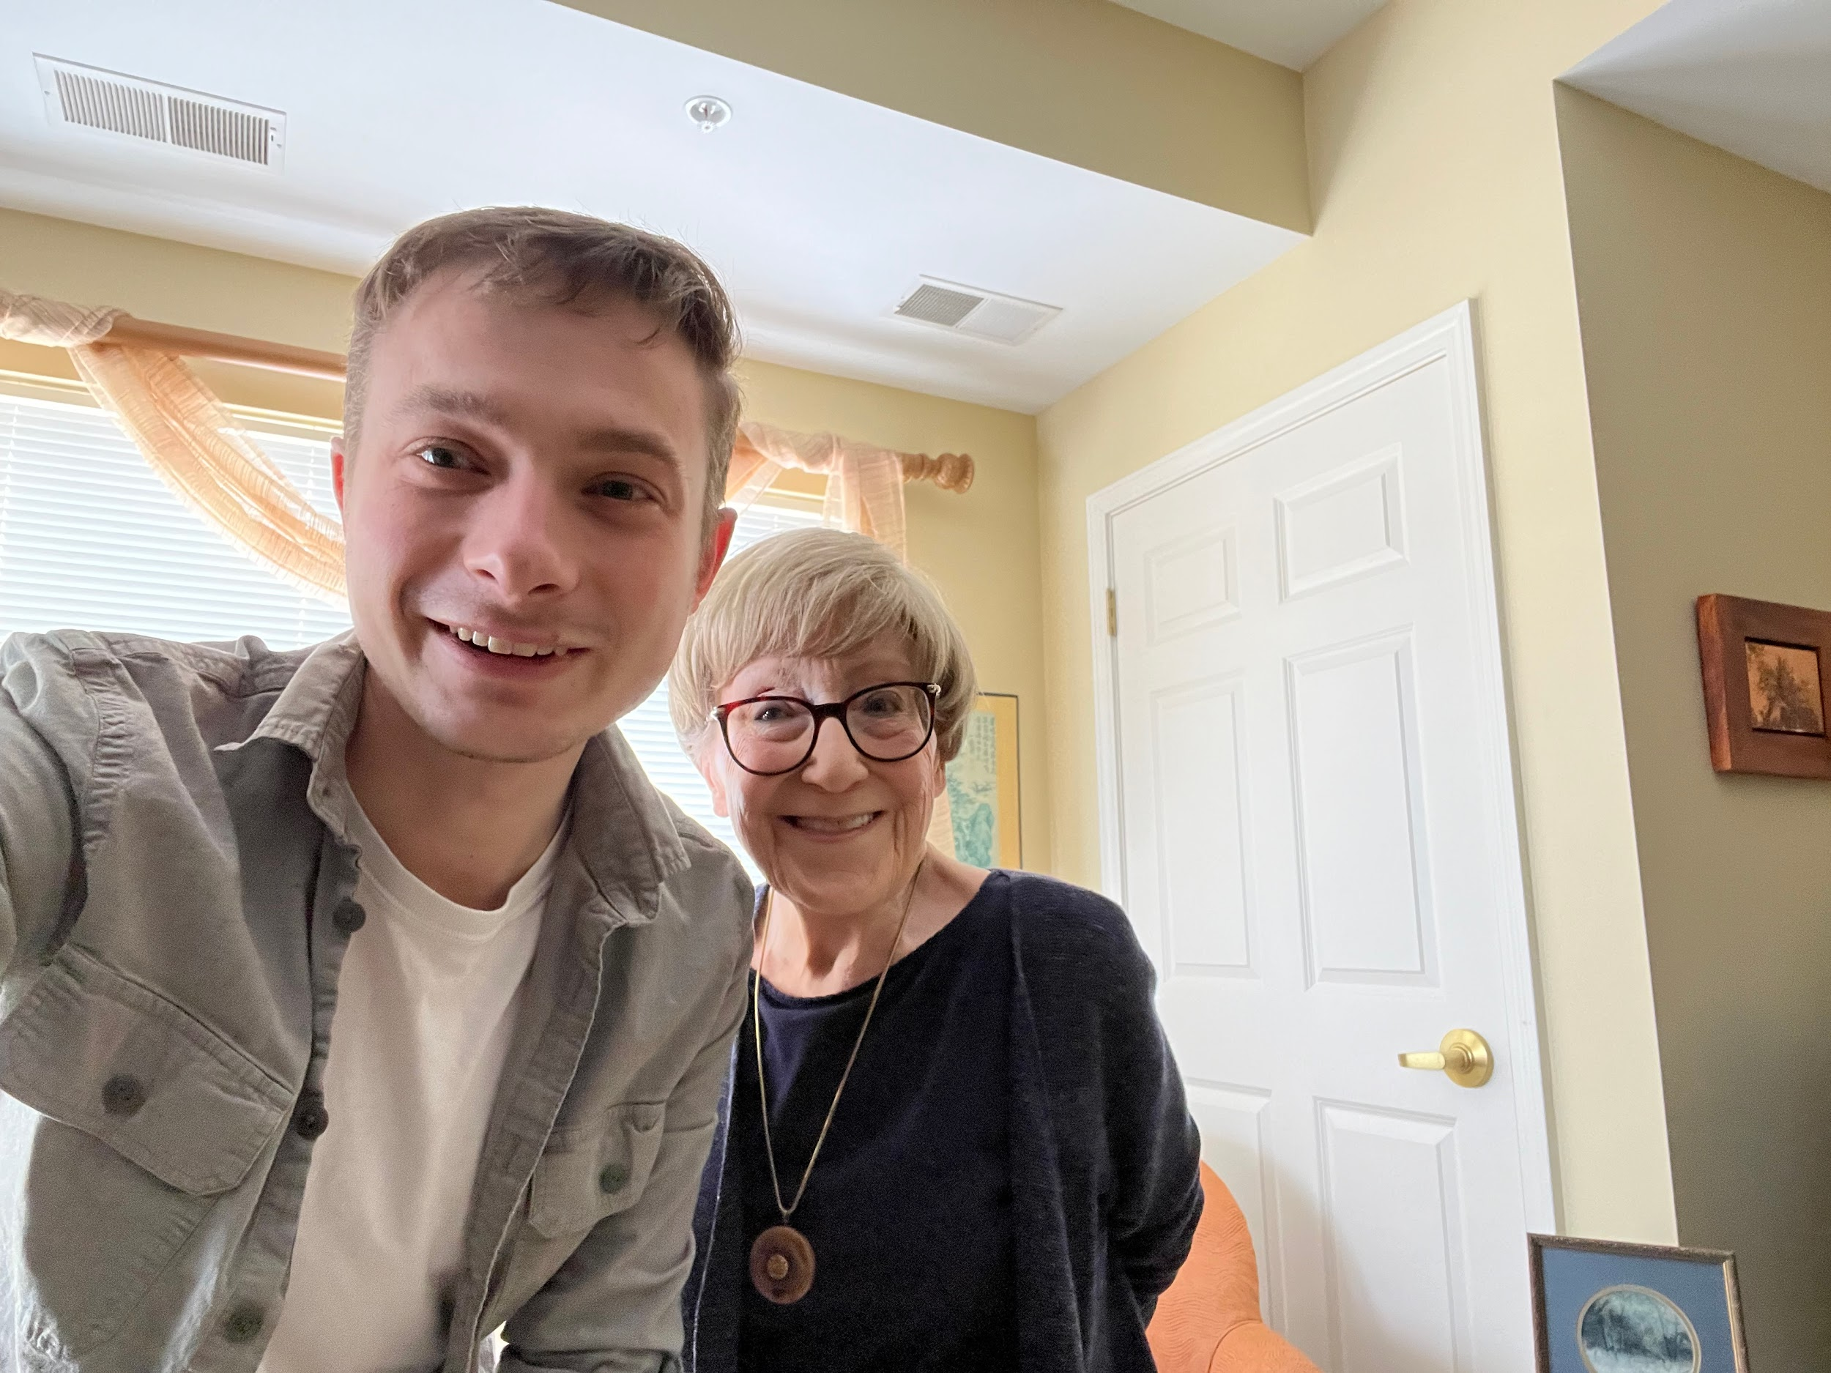
Dedication
This course dedicated to my grandmother who taught me how technology can help us become more human.
Thank you. Rest in peace.

Slide 13
A moment of reflection

Slide 14
Works cited
N. Hayes, "Data Visualization for Education: When Asking Questions is the Answer," Stamen, 2023. Available: https://stamen.com/data-visualization-for-education-when-asking-questions-is-the-answer/
S. Lourterwasser and Crash Course, "Crash Course Sociology," Crash Course, 2017. Available at: https://thecrashcourse.com/topic/sociology/
A. Thorn, "Philosophy Tube," Philosophy Tube. Available: https://www.youtube.com/@philosophytube
D. Shiffman, The Nature of Code, No Starch Press, 2024. Available: https://natureofcode.com/
Eyeo Festival, "Eyeo Festival," Eyeo Festival. Available: https://eyeofestival.com/
M. Brown, "Game Maker's Toolkit," Game Maker's Toolkit. Available: https://gamemakerstoolkit.com/
J-M8, "Design Delve," Second Wind. Available: https://www.youtube.com/watch?v=LR2vQO_BHC0&list=PLUBKwq0XD0uc3-bC1m0IYvbdu8dEX4rd2
Extra Credits, "Extra Credits," Extra Credits. Available: https://www.youtube.com/@extracredits
H. Horst and D. Miller, Digital Anthropology, Routledge, 2012.
A. Shvets, "Refactoring Guru," Refactoring Guru. Available: https://refactoring.guru/

Slide 15
