Slide 1
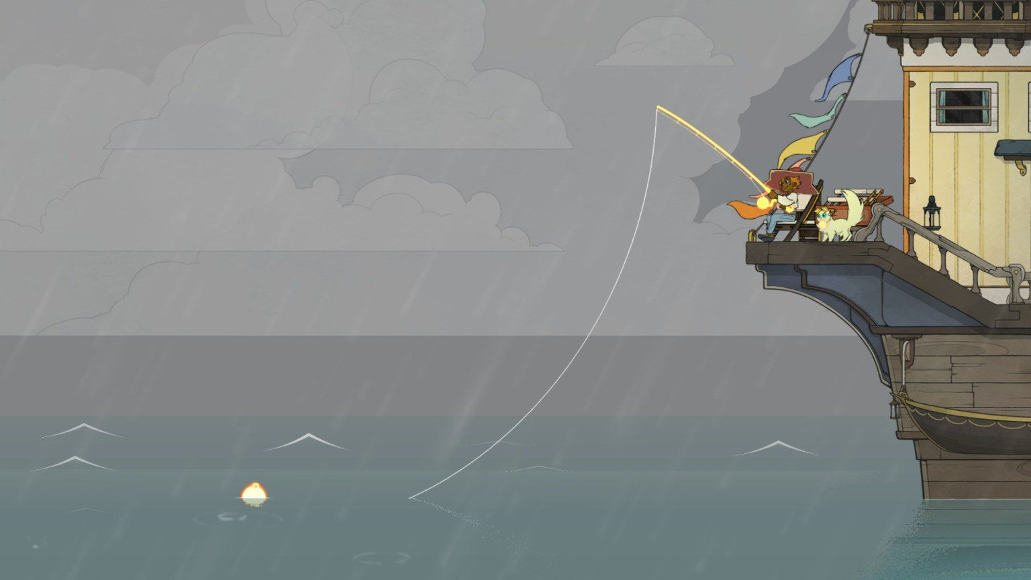
Architecture
A Samuel Pottinger
Stat 198: IDSV
April 7, 2025

Slide 2
Quick note about the rest of class
Wednesday (make up on Friday): Interactive experience discussions
Friday: BART visualization
Monday: Interactive visualization extension (assigned today)
May 14: Final project (assigned on Wednesday)

Slide 3
Today
Example of level design.
Three architectures applied to data visualization from games.
Revisiting the AFSC GAP visualization.
Mario Level 1-1

Slide 4

An example of level design / architecture

Slide 5
Today
Example of level design.
Three architectures applied to data visualization from games.
Revisiting the AFSC GAP visualization.
Mario Level 1-1

Slide 6
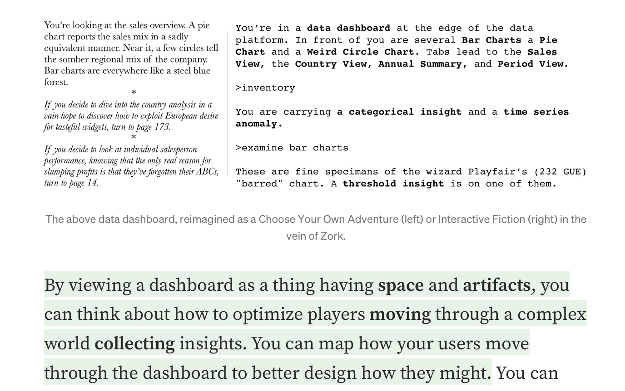
Architecture 3: Levels
Levels: Modulate what is visible to the user at any given moment in time, offer hints towards other areas.
https://illinois-soil-health-tool.org/

Slide 7
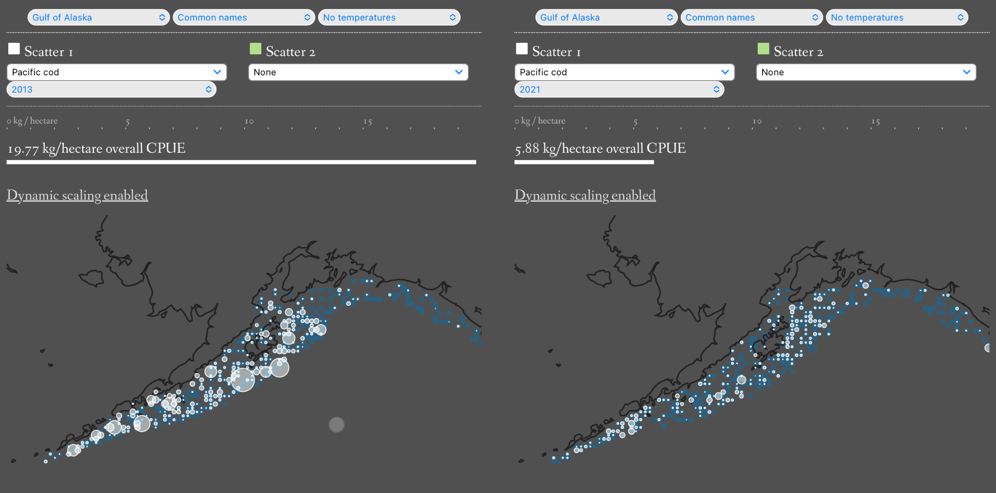
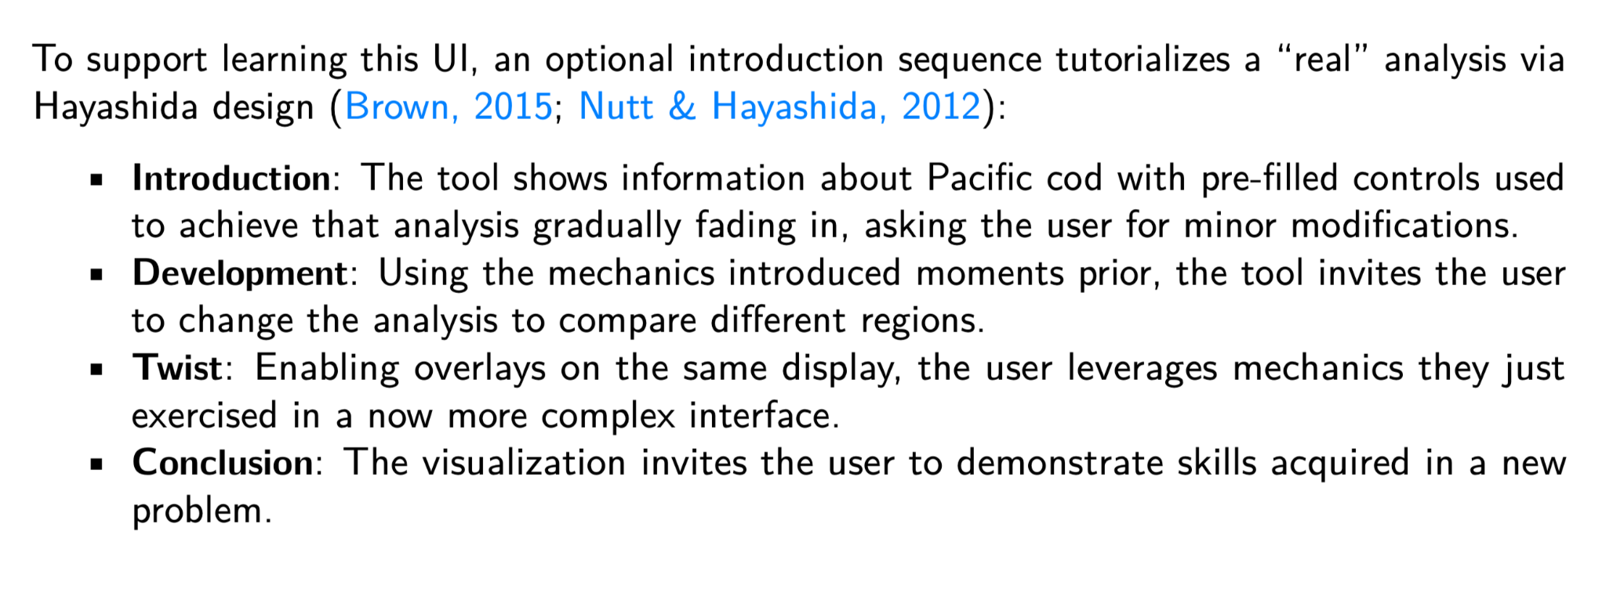
Architecture 2: Hayashida Design

Slide 8
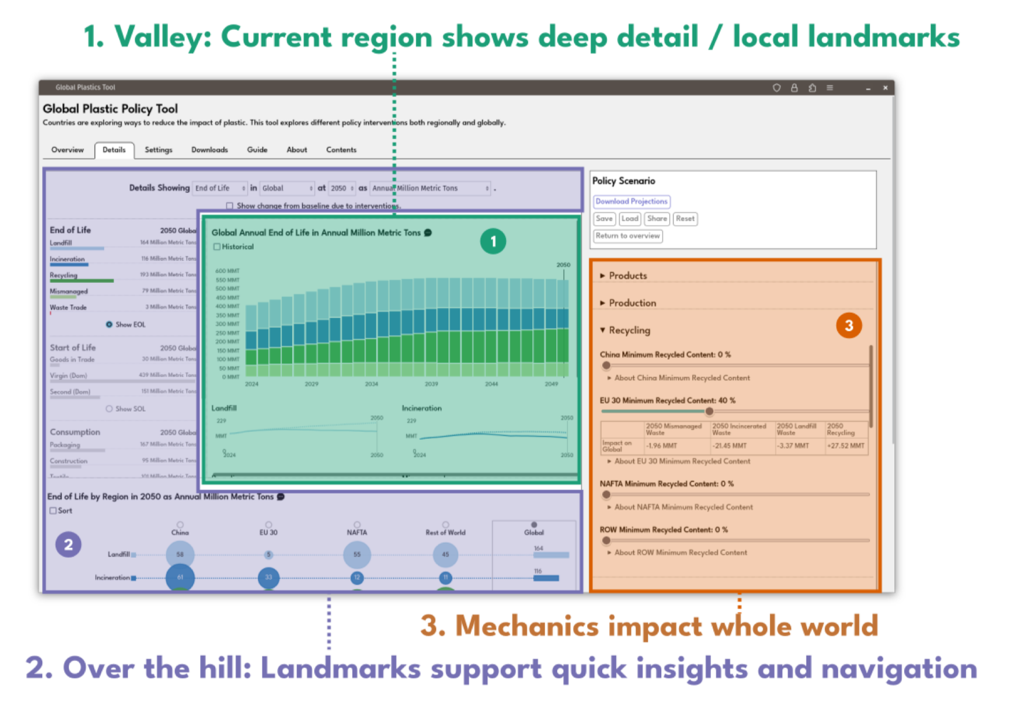
Architecture 3: Triangle Design
Valleys and hills: Modulate what is visible to the user at any given moment in time, offer hints towards other areas.
https://global-plastics-tool.org
http://www.noceilings.org

Slide 9
Today
Example of level design.
Three architectures applied to data visualization from games.
Revisiting the AFSC GAP visualization.
Mario Level 1-1

Slide 10
Today
Example of level design.
Three architectures applied to data visualization from games.
Revisiting the AFSC GAP visualization.
Mario Level 1-1

Slide 11

Mario World 1-1

Slide 12
Citations
G. Nicoli, "Spiritfarer: la morte felice," Ludica, 2020. Available: https://www.ludicamag.com/spiritfarer-la-morte-felice/
M. Brown, "Super Mario 3D World's 4 Step Level Design," Game Maker's Toolkit, 2015. Available: https://www.youtube.com/watch?v=dBmIkEvEBtA
A. Pottinger and G. Zarpellon, "Pyafscgap.org: Open source multi-modal Python-based tools for NOAA AFSC RACE GAP," JOSS, 2023. doi: 10.21105/joss.05593.
D. Emmons and J. Portnow, "Design Club - Super Mario Bros: Level 1-1," Extra Credits, 2014. Available: https://www.youtube.com/watch?v=ZH2wGpEZVgE
"Illinois Soil Health," University of California, 2023. Available: https://illinois-soil-health-tool.org/
E. Meeks, "Designing a Data Visualization Dashboard Like It was a Game," Nightingale, 2018. Available: https://medium.com/nightingale/designing-a-data-visualization-dashboard-like-it-was-a-game-b347858c1bce
A. Pottinger, N. Biyani, R. Geyer, D. J. McCauley, M. de Bruyn, M. R. Morse, N. Nathan, K. Koy, and C. Martinez, "Combining Game Design and Data Visualization to Inform Plastics Policy: Fostering Collaboration between Science, Decision-Makers, and Artificial Intelligence," Arxiv, 2023. Available: https://arxiv.org/abs/2312.11359.
Fathom Information Design, "No Ceilings," The Clinton Foundation, 2015. Available: http://www.noceilings.org/

Slide 13


