Slide 1
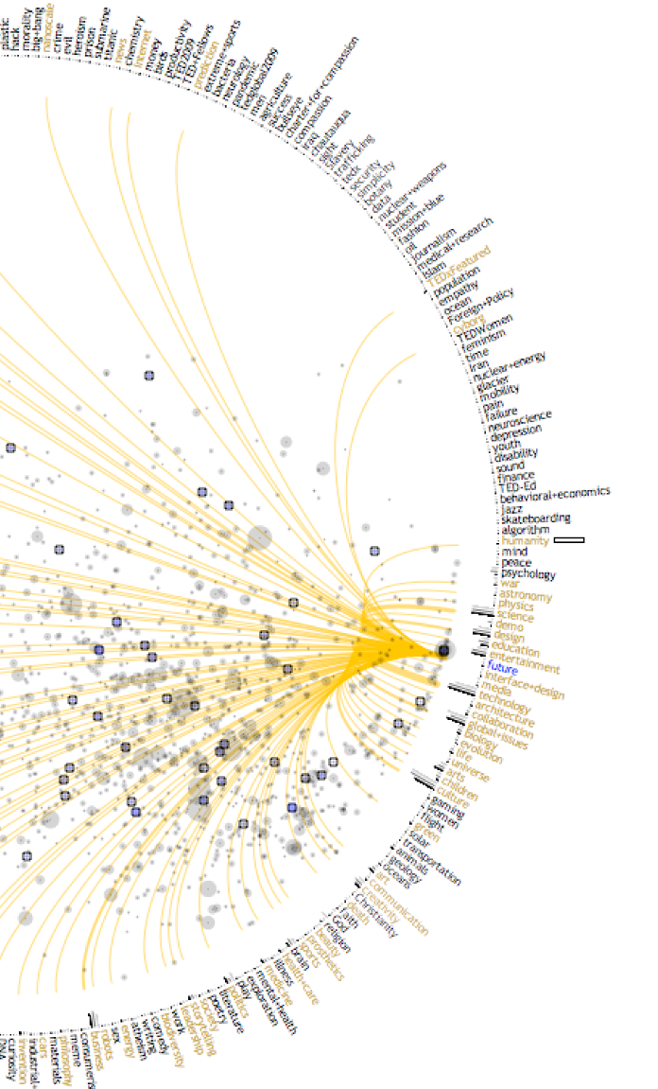
Design Research
A Samuel Pottinger
Stat 198: IDSV
Mar 17, 2025

Slide 2
Why design research?
We’ve learned about encoding devices, tasks, domains, patterns, and so much more.
What are the right questions to ask within a data visualization, what are the most important variables that we should include, how should we prioritize our encoding devices?
The answer lies in understanding the user.

Slide 3
However…
This is not a class on user research methods in human-centered design.

Slide 4
However…
This is not a class on user research methods in human-centered design.
That can often span many lectures or even full courses.
My goal today is just to give you a sense of how it is done and give you one specific tool that can be useful for visualization measurement and evaluation.
Employing some of these techniques may involve ethical considerations and training depending on the circumstance.

Slide 5
What is design research?
See Links…

Slide 6
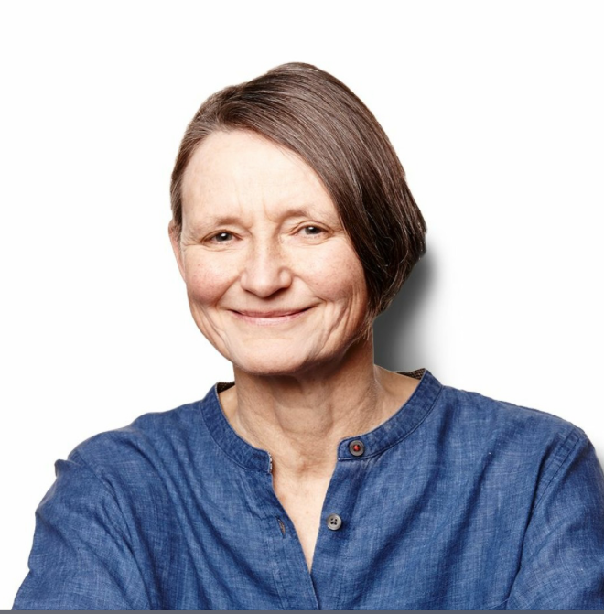
What is design research?
Catching up with Jane Fulton Suri: In the design of physical products, the goal was to create an object that effectively signaled its function to the user. Other designers focused on the meaning people placed on artifacts, rituals, and behaviors and how to incorporate those interactions into their work. In Scandinavia, designers began including the end user in the process early on, focusing on co-creation. As the practice of human-centered design became more defined, the various ways people solved for design challenges came together into a more comprehensive approach, and IDEO pulls from many of these ideas today.

Slide 7
A brief glimpse at underpinnings
We have a cultural and experiential lens through we we observe the world and this includes visualizations (diagrammatic thinking).
The question is if we can, without judgement, learn about the experiences of others (design empathy).
We center outside and often lived expertise to understand experiences but also how symbols including objects get meaning within those experiences and social systems (symbolic interactionism).

Slide 8
Today
> Talking to users: the basics of a user interview.
Group activity: try out the user interview.
Observing users: the basics of a contextual inquiry.
Think-Aloud: the basics of measurement / evaluation.
Co-design: another option.

Slide 9
Leave it open ended, follow them.
User interviews may be used in learning about a product, population, system, process, etc. Try to ask open ended questions which allow the user to guide you to new topics:
Why are those goals important?
Who works with you on those goals?
How did those deadlines get set?
Who, what, when, where, and why are all helpful but why, who, and how can be particularly generative.

Slide 10
Leave it open ended, follow them.
Learning about a thing but also the context of that thing:
Can you describe your day yesterday.
What did you feel going through that process?
Why is that good or bad and how do you know?
What causes that to happen?
How often does that happen?
What tools do you use to accomplish this goal?
How do you collaborate on this with others?
It is best to ask about specific and, when possible, recent actual events.

Slide 11
Some techniques
Echoing: You said that it was difficult to use, why is that the case?
Silence: …
That’s interesting redirect: That’s interesting thank you. I also wonder if you could tell me about…
Advice to someone else: What would you tell someone else who is thinking of using this software in the future?
Advice to past self: If you could give your past self advice, what would you say?
End with magic wand: If you change anything about this, what would it be?

Slide 12
Some things to avoid
Dead ends: is that your preferred software -> why is that your preferred software.
Judgement: why is this tool is difficult to use -> how does it feel to use this tool?
Leading: what have you done to improve this process -> has the process changed over time?
Avoid the double-barrel: what do you like and dislike about this tool -> what do you like about this tool? what do you dislike about this tool?

Slide 13
Today
Talking to users: the basics of a user interview.
> Group activity: try out the user interview.
Observing users: the basics of a contextual inquiry.
Think-Aloud: the basics of measurement / evaluation.
Co-design: another option.

Slide 14
Find a partner, ask about a class.
Find another partner here in the room (can make a group of 3 if needed). Ask them about a class that you haven’t taken.
Why did they take it?
What was their perception of the outcome of having taken the course?
Why did they have that perception?

Slide 15
Today
Talking to users: the basics of a user interview.
Group activity: try out the user interview.
> Observing users: the basics of a contextual inquiry.
Think-Aloud: the basics of measurement / evaluation.
Co-design: another option.

Slide 16
Contextual inquiry
It’s kind of like a user interview but in action.
The goal is to observe a specific situated experience.
The primary goal is to observe and ask non-disruptive questions.
Best when in the course of regular activity.
Go with a beginner’s mind and without judgement.

Slide 17
Today
Talking to users: the basics of a user interview.
Group activity: try out the user interview.
Observing users: the basics of a contextual inquiry.
> Think-Aloud: the basics of measurement / evaluation.
Co-design: another option.

Slide 18

Lots of options for measurement and evaluation

Slide 19
The easiest is observing with a simple prompt.
Please go through this tutorial and while doing so, please try your best to think aloud.

Slide 20

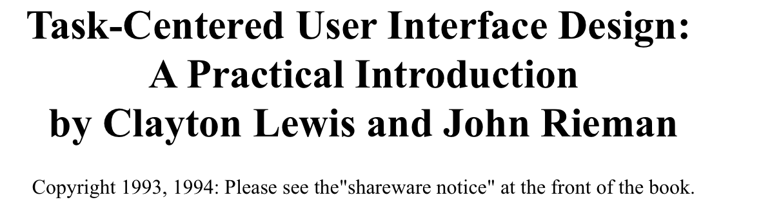
The easiest is observing with a simple prompt.
Please go through this tutorial and while doing so, please try your best to think aloud.

Slide 21
Today
Talking to users: the basics of a user interview.
Group activity: try out the user interview.
Observing users: the basics of a contextual inquiry.
Think-Aloud: the basics of measurement / evaluation.
> Co-design: another option.

Slide 22
About co-design
Break down the distinction between users and designer, instead invite in partners.
Allow others to fundamentally guide process in conceptualization and design.
Often works well when you can make a long term repeated relationship.
Can be effective for more involved feedback, especially for expert tools.

Slide 23
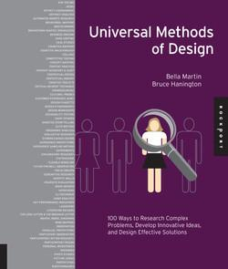
Final thought

Slide 24
Citations
"The Deep Dive: One Company's Secret Weapon for Innovation," ABC News, 1999.
"The Art of the Insight: Learnings from 30 Years of Curiosity and Empathy," IDEO U, 2019. Available: https://www.ideou.com/blogs/inspiration/the-art-of-the-insight-learnings-from-30-years-of-curiosity-and-empathy
C. Nickerson, "Symbolic Interactionism Theory & Examples," Simply Pscyhology, 2025. Available: https://www.simplypsychology.org/symbolic-interaction-theory.html
J. Tong, "Diagrammatic thinking and audience reading of COVID-19 data visualisations: A UK case study," Convergence, 2024. doi: 10.1177/13548565241309886.
B. Hanington and B. Martin, "Universal Methods of Design," Rockport Publishers, 2012.
"User Interview Example Questions," Yale University. Available: https://usability.yale.edu/understanding-your-user/user-interviews/user-interview-example-questions
J. Gallegos, "50 Powerful User Interview Questions You Should Consider Asking," Respondent, 2022. Available: https://blog.respondent.io/best-user-interview-question
B. Shneiderman and C. Plaisant, "Strategies for Evaluating Information Visualization Tools: Multi-dimensional In-depth Long-term Case Studies," BELIV '06, 2006. doi: 10.1145/1168149.1168158
C. Lewis and J. Rieman, "Task-Centered User Interface Design: A Practical Introduction," HCI Bibliography / IBM Research, 1993. Available: https://www.hcibib.org/tcuid/
C. Lewis, "Clayton Lewis" Available: https://sites.google.com/view/clayton-lewis.

Slide 25
