Slide 1
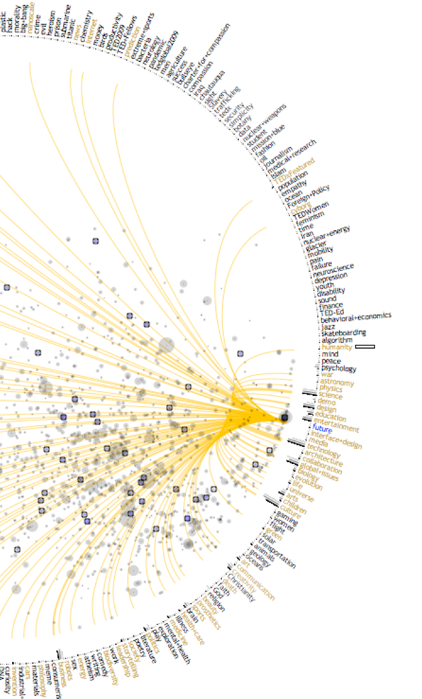
Formalizing
Glyphs
A Samuel Pottinger
Stat 198: IDSV
Mar 3, 2025

Slide 2
End of the second section.
Cleveland and McGill + Others:
Today we are moving from meeting the ingredients to understanding when to use them.

Slide 3
Today
> Cleveland and McGill: ranking of encodings.
Group activity: which graphic is more likely to be read accurately?
Working in limitations: shared axes, dual axes, and direct labeling.
Revisiting chart junk: how to keep channels clear.

Slide 4
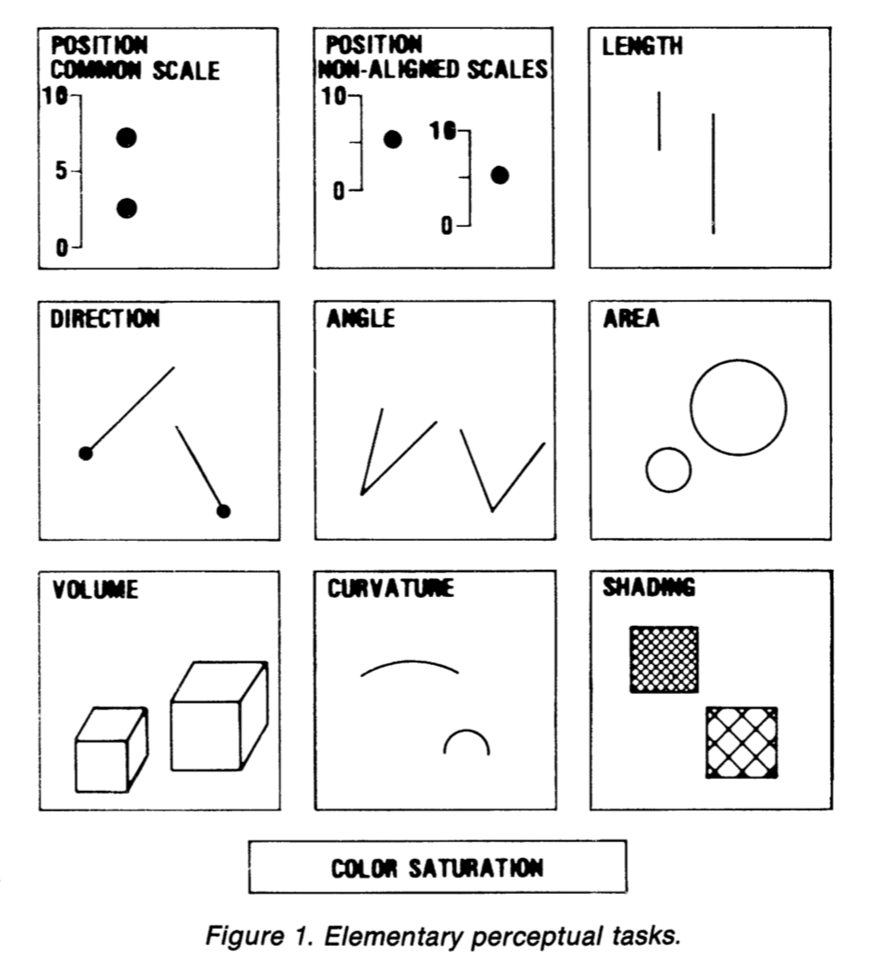
Cleveland and McGill
We’ve explored why pre-attentive features exist and how glyphs are processed.
However, what is the right design of glyphs?
Presenting on Cleveland and McGill in addition to some work that came after as cited.

Slide 5
Fairly robust hierarchy
Higher Accuracy
Lower or Inconsistent

Slide 6
Fairly robust hierarchy
The highest accuracy encoding device is potentially not surprising as it underpins scatter plots.
Going to back to preattentive features and the Gestalt Principles, position is really the first choice.

Slide 7
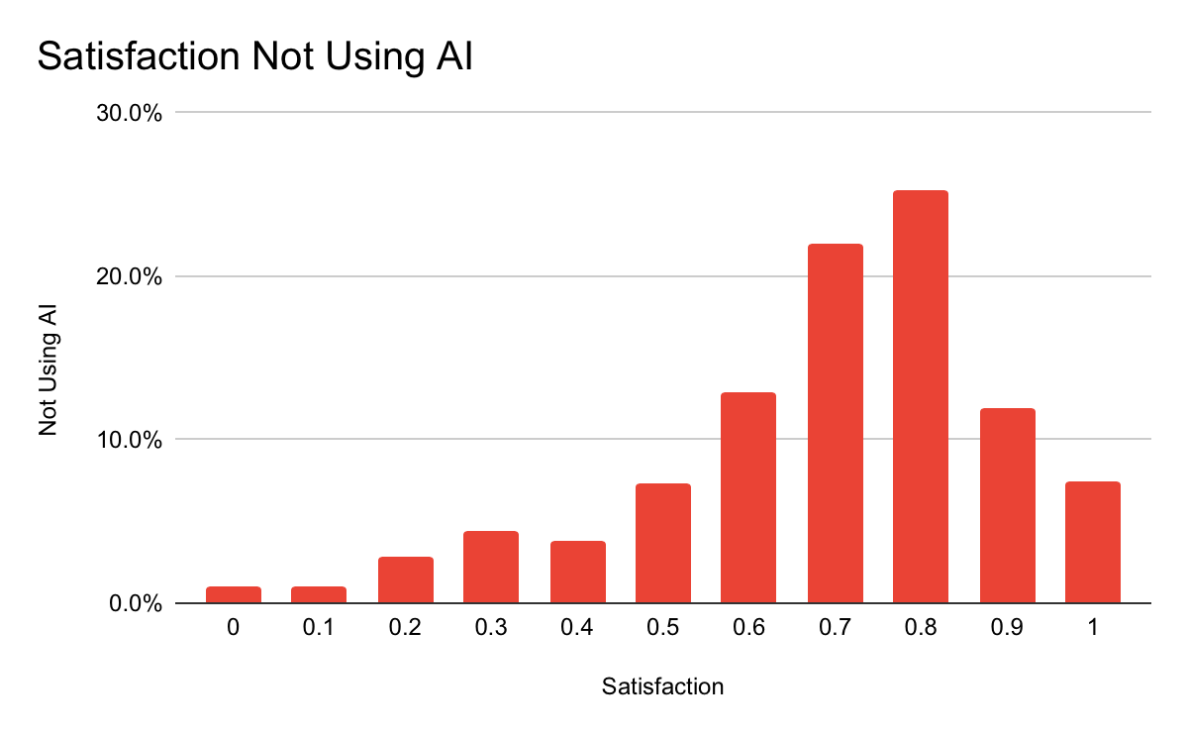
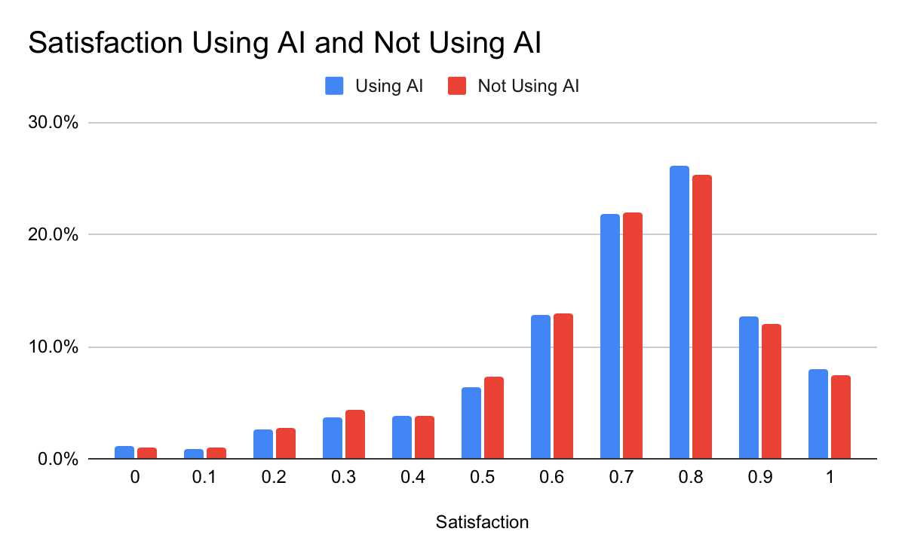
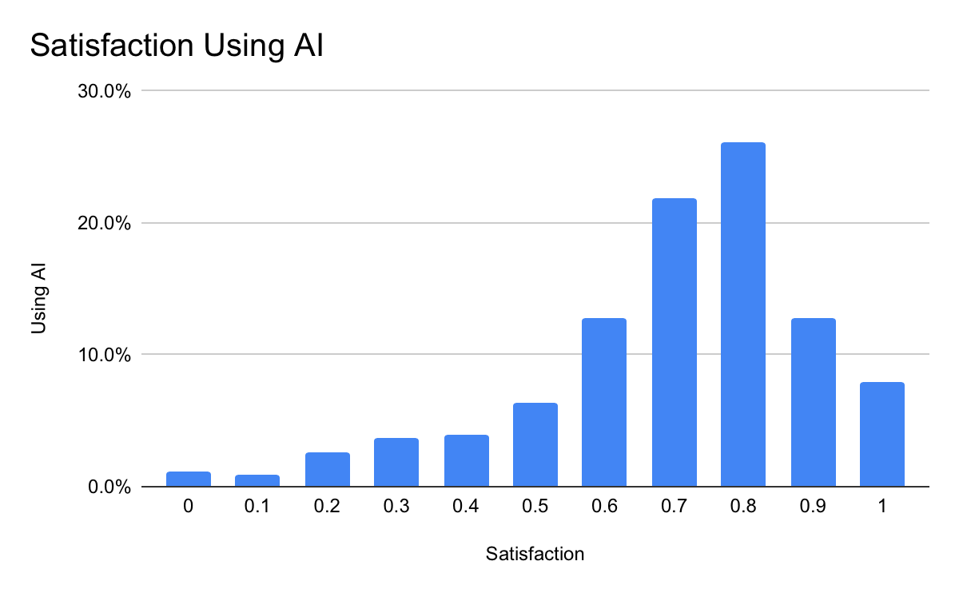
Fairly robust hierarchy

Slide 8
Fairly robust hierarchy

Slide 9
Fairly robust hierarchy
I am placing length higher than direction (slope) and angle because of consistency. There’s evidence that we do better with angle closer to cardinal directions.
This is why pie charts may perform relatively poorly. Length typically has an easy fix: align against a common axis.

Slide 10
Fairly robust hierarchy
Volume generally never goes well. This may be partially due to 3D representation within 2D media.
In general, area is good for less important “contextualizing” metrics.
Area has an issue: area vs radius.

Slide 11
Fairly robust hierarchy
Returning to the lessons of our earlier lectures, color is fairly unreliable. It is often better for branding or complementing a message through emotion and aesthetic than it is for conveying quantitative information.
It may still serve a purpose for a limited number of qualitative groups.
Lightness generally better than hue.

Slide 12
Today
Cleveland and McGill: ranking of encodings.
> Group activity: which graphic is more likely to be read accurately?
Working in limitations: shared axes, dual axes, and direct labeling.
Revisiting chart junk: how to keep channels clear.

Slide 13
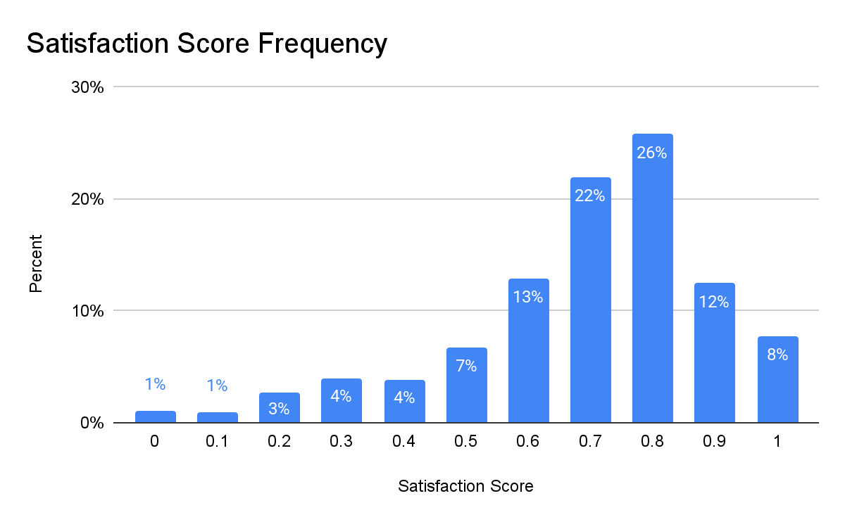
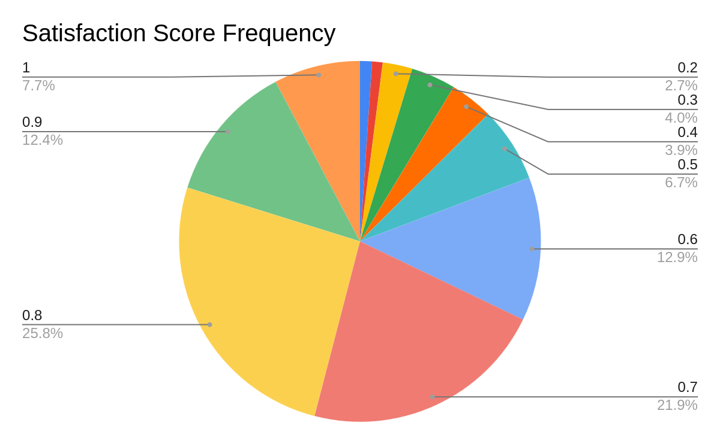
Which one is more likely to be successful?

Slide 14
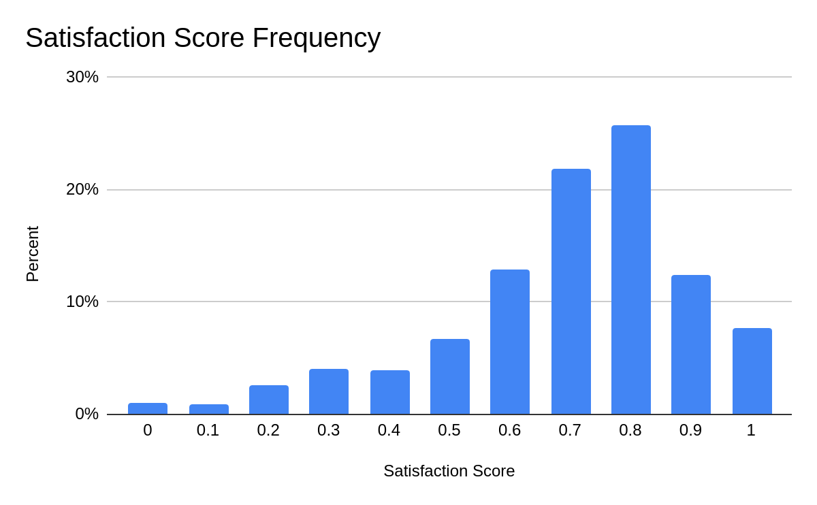
Which one is more likely to be successful?
Satisfaction Score | Percent
0
0.1
0.2
0.3
0.4
0.5
0.6
0.7
0.8
0.9
1

Slide 15
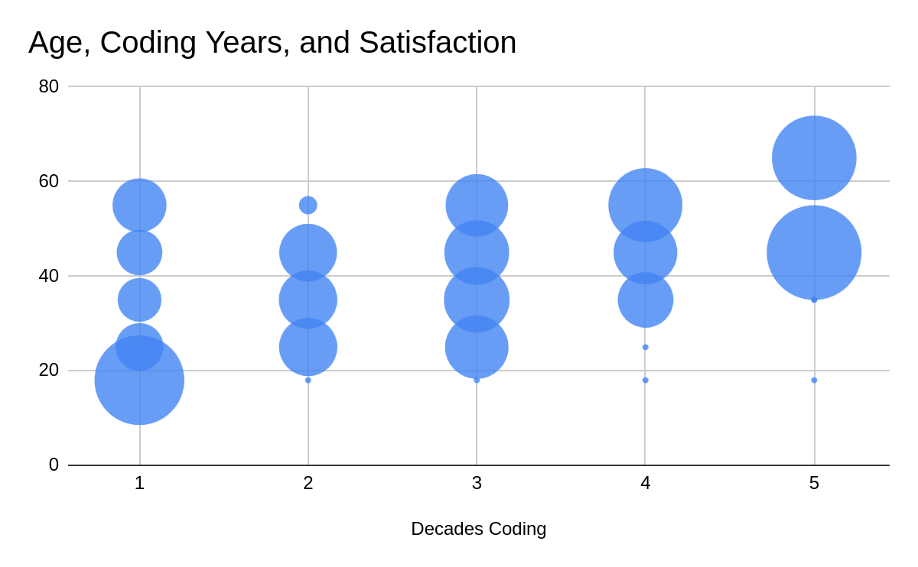
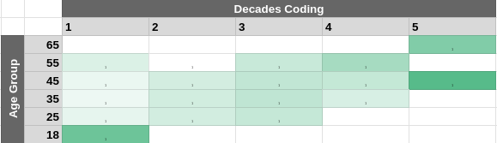
Which one is more likely to be successful?

Slide 16
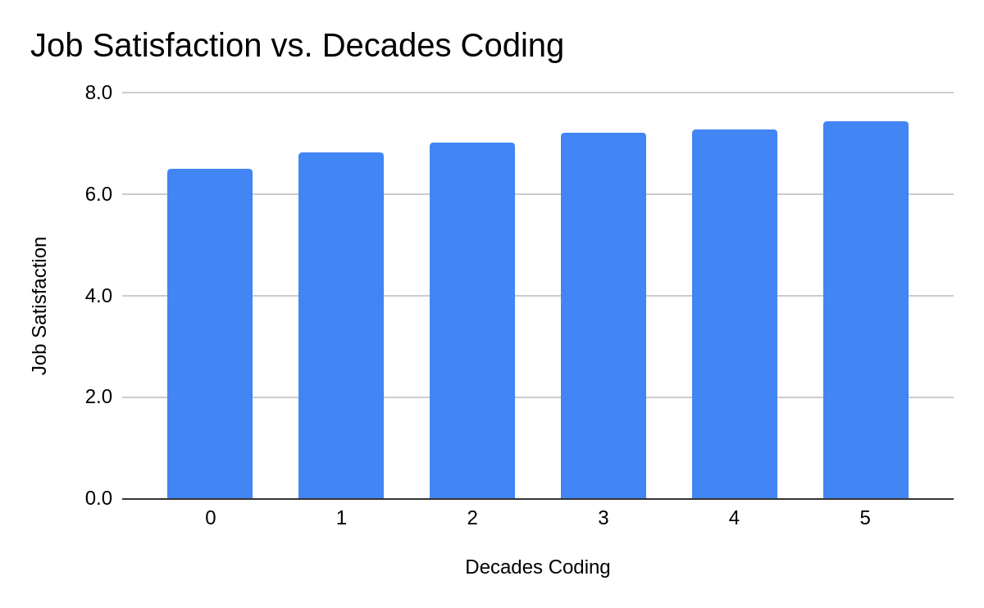
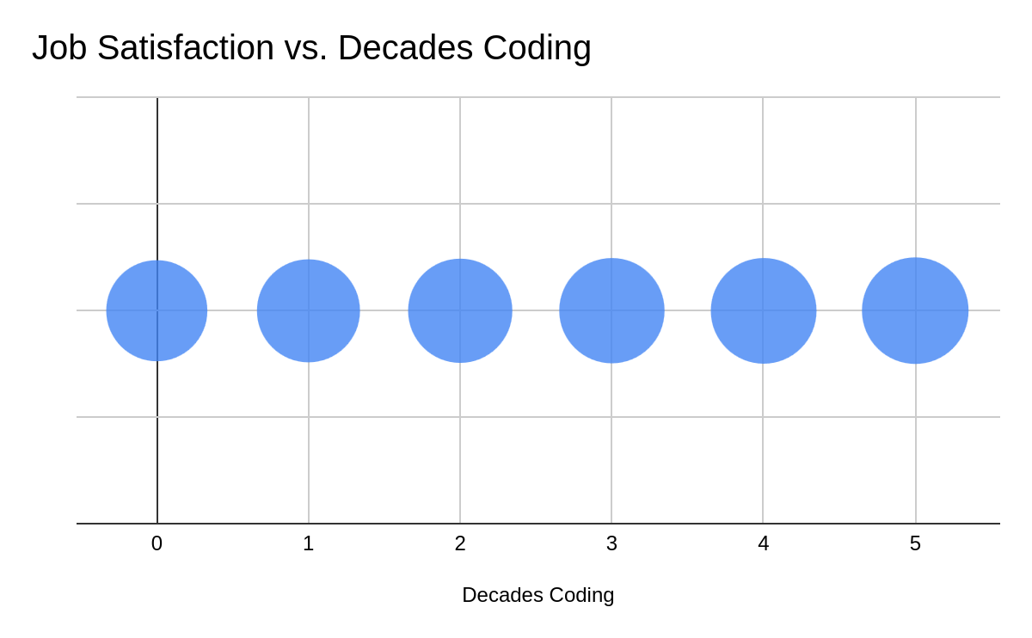
Which one is more likely to be successful?

Slide 17
Today
Cleveland and McGill: ranking of encodings.
Group activity: which graphic is more likely to be read accurately?
> Working in limitations: shared axes, dual axes, and direct labeling.
Revisiting chart junk: how to keep channels clear.

Slide 18
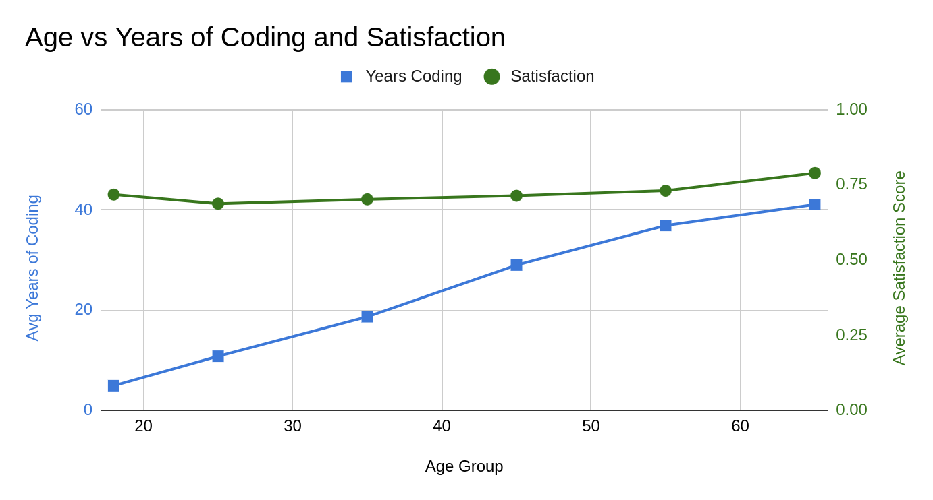
Dual Axes

Slide 19
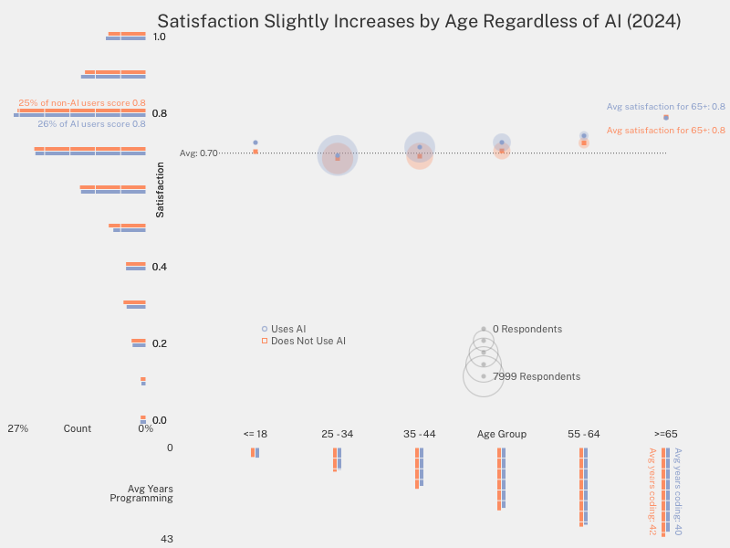
Shared Axes

Slide 20
Direct Labeling

Slide 21
Today
Cleveland and McGill: ranking of encodings.
Group activity: which graphic is more likely to be read accurately?
Working in limitations: shared axes, dual axes, and direct labeling.
> Revisiting chart junk: how to keep channels clear.

Slide 22
Keeping channels clear

Slide 23
Keeping channels clear

Slide 24

Quick Pause
Cleveland and McGill
Group activity
Working in limitations
Revisiting chart junk

Slide 25
Quick Pause 1
Upcoming Assignment
Intentional labeling.
Removal of chartjunk.
Negative space grid.
Shared axes styling.
Future: interaction.

Slide 26
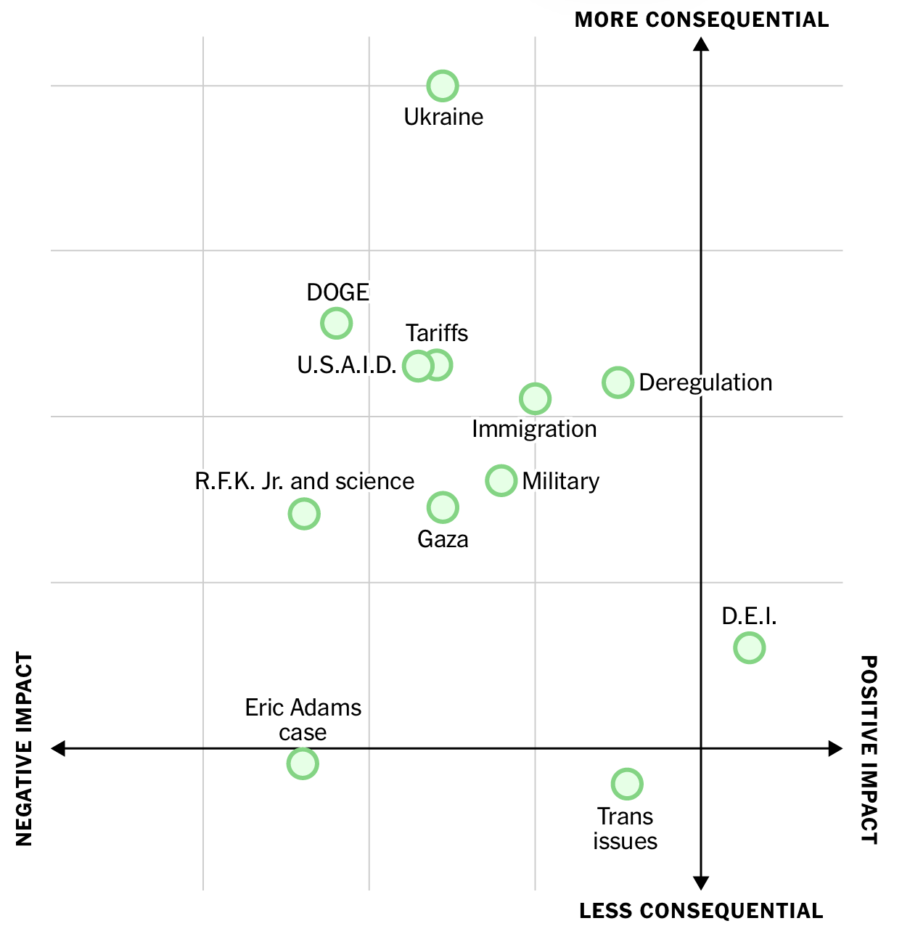
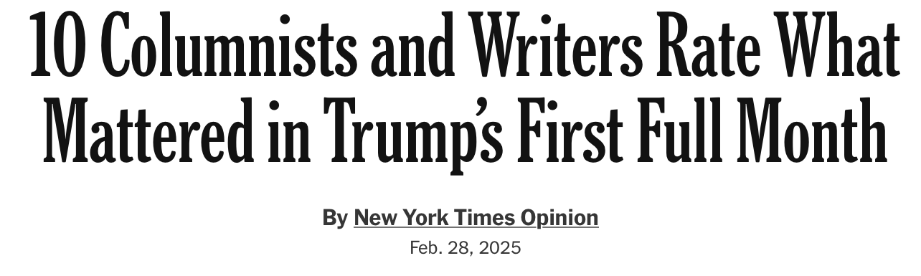
Quick Pause 2

Slide 27
Works Cited
A. Pottinger, "TED Visualization," Gleap.org. Available: https://gleap.org/content/ted_visualization
W. Cleveland and R. McGill, “Graphical Perception: Theory, Experimentation, and Application to the Development of Graphical Methods,” Journal of the American Statistical Association, 1984. Available: https://www.jstor.org/stable/2288400
“Stack Overflow Annual Developer Survey 2024,” Stack Exchange Inc, 2024. Available: https://survey.stackoverflow.co/
C. Ware, “Information Visualization: Perception for Design (Interactive Technologies),” Morgan Kaufmann, 2012.
A. Cairo, “The Truthful Art,” New Riders, 2016.
NYT Opinion, “10 Columnists and Writers Rate What Mattered in Trump’s First Full Month,” New York Times Company, 2025. Available: https://www.nytimes.com/interactive/2025/03/01/opinion/trump-administration-first-month.html.

Slide 28


