Slide 1
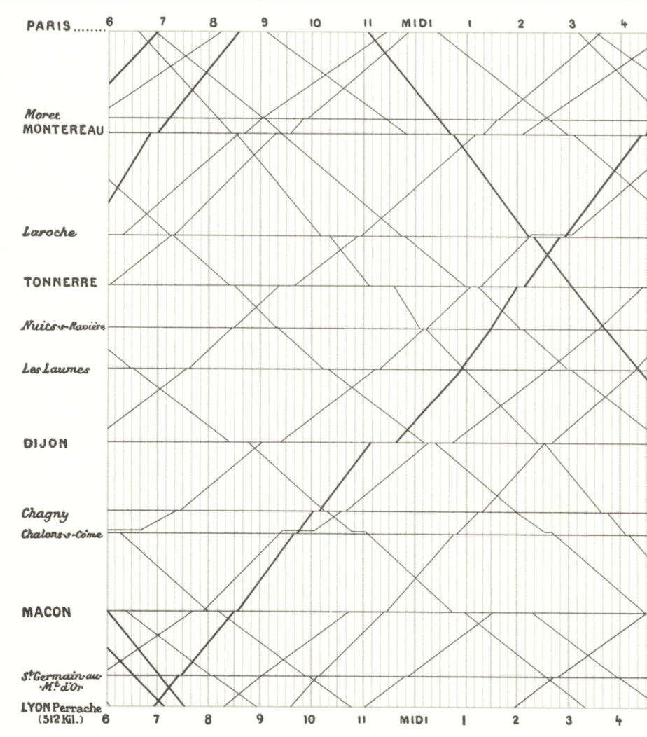
Skills Lab 2
A Samuel Pottinger
Stat 198: IDSV
Feb 3, 2025

Slide 2
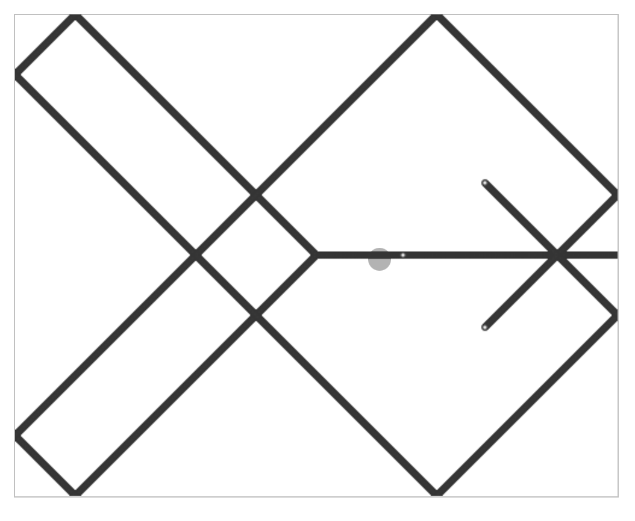
Goal is to get through Tutorial 3.
Tutorial 3 ties together a few concepts we started looking at in our first skills lab, exploring custom objects for creative coding.
https://interactivedatascience.courses/labs

Slide 3
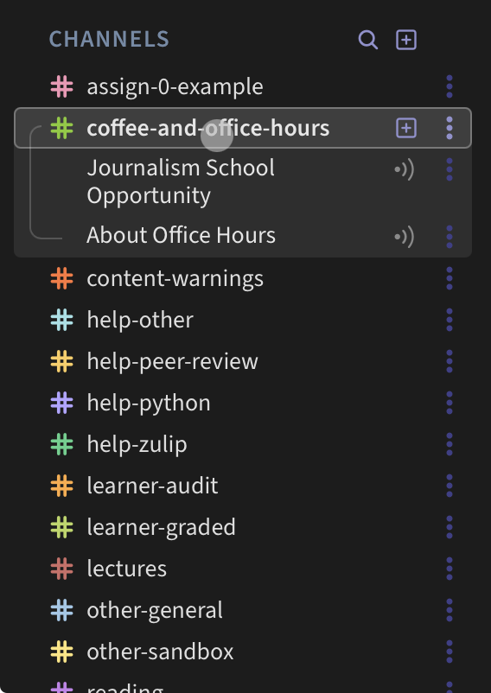
Flipped Classroom

Slide 4
Sources for imagery
https://badriadhikari.github.io/data-viz-workshop-2021/minards/

Slide 5
